Slide 1
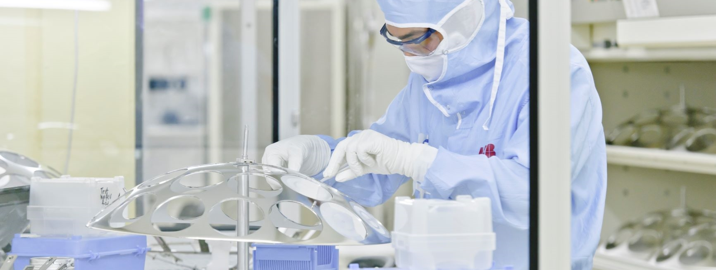
HAPG high-quality Modules expand to Medium Power
Lenzburg, November 2020
Christian Winter, Global Product Manager, Hitachi ABB Power Grids, Switzerland Ltd, Semiconductors

Slide 2
Medium Power Thyristor / Diode Modules
Coming from high-power semiconductors, HAPG is regarded as one of the world’s leading suppliers setting standards in performance and quality.
HAPG’s unique knowledge in high-power semiconductors now expands to industry standard medium-power thyristor/diode modules.

Slide 3

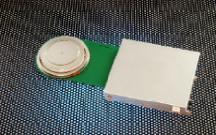


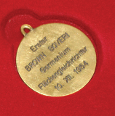
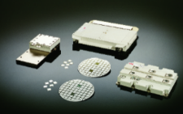


Knowledge in high-power semiconductors
for more than 65 years
1981
Development of high power semiconductor factory in Lenzburg, Switzerland
1996
Beginning of production of IGCT in Lenzburg, Switzerland
2010
Expansion of production facilities in Lenzburg, Switzerland
2014
Inauguration of new state of the art research laboratory in Dättwil, Switzerland
1954
BBC develops the first germanium diode
1998
Inauguration of production facilities for IGBT in Lenzburg, Switzerland
2010
Acquisition of Polovodice in Prague, Czech Republic
2012
Successful design and development of hybrid HVDC breaker

Slide 4
Quality from high-power semiconductors
High quality and process reliability levels
High level of quality and process reliability documented in various audits.
Quality management and quality assurance.
Enhanced testing, highest reliability and very few field returns.
Benchmark in ppm and FIT rate for premium products.
Zero Defects methods applied.

Slide 5
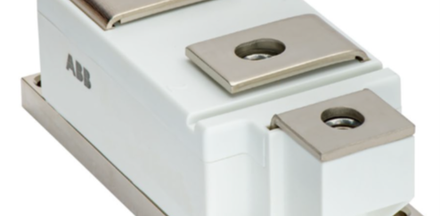
60Pak – Thyristor / Diode module

Slide 6
Thyristor / Diode Modules
60Pak
HAPG’s power semiconductors provide the ultimate in reliability and are the epitome of quality
Whether efficiently driving industrial motors, smoothly accelerating fans and pumps or supply power to demanding applications – failure is not an option
After successfully launching IGBT medium power modules, HAPG is introducing a BiPolar power module perfecting the art of ultimate reliability – the 60Pak
The key benefits of the new 60Pak are highest performance, outstanding reliability and increased overload capability.
All highest quality HAPG assets wrapped in a standard industrial housing.

Slide 7
Features and Application
Thyristor / diode Module features
Applications
Precisious pressure contacts for high reliability and load cycling capability
60 mm Industry standard housing
Insulated baseplate by AIN ceramic ensures excellent heat transfer and high insulation voltage level.
Very low losses together with the highest operating temperatures.
UL recognized
Voltage range 1.8 - 2.2 kV
Forward current up to 890 A
Uncontrolled line frequency bridge arm in medium voltage drives
Input rectifiers in AC/AC converters
DC power supply for applications such as industrial and renewables.
AC motor soft starters and variable speed drives in applications such as industrial and renewables

Slide 8
Portfolio outlook
Target ratings 60Pak
Configurations
¹ Product qualified

